Slide 1

Central Kansas Community Corrections

Slide 2
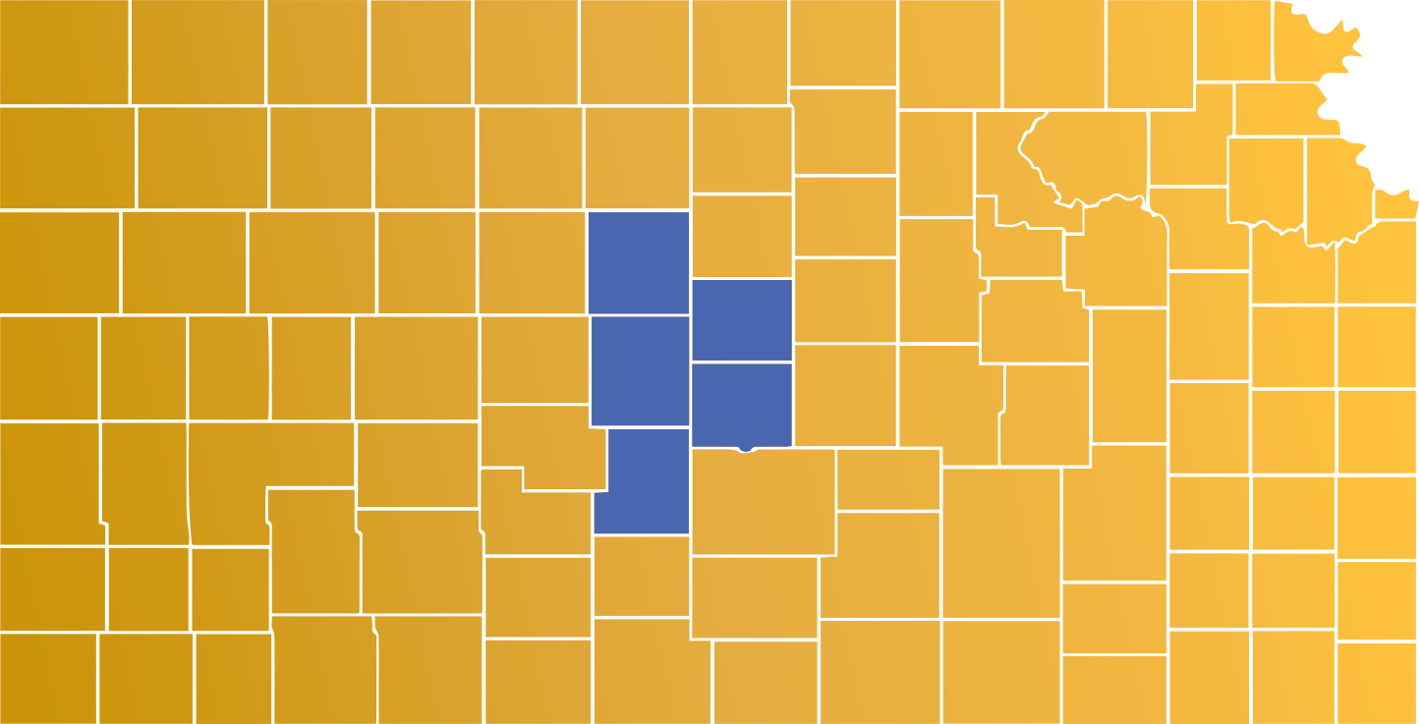
Barton,
Ellsworth,
Rice,
Russell and
Stafford Counties
20th Judicial District:
The District’s population = 51,000
CKCC’s population = 300

Slide 3
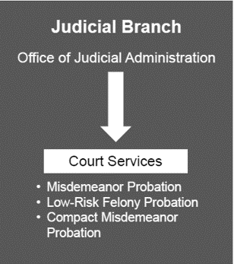
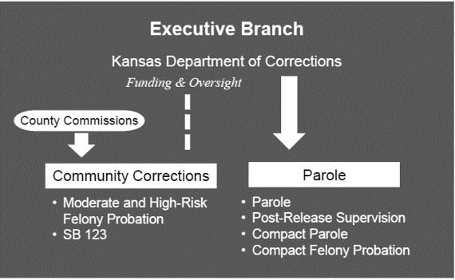
Current Community Supervision Structure

Slide 4

Community Corrections quick overview
State funded through grants to county government.
Barton County employees.
Community supervision of higher-risk offenders who are not incarcerated, but in our communities.
Two outcomes of the program: remain in the community or enter the prison system.

Slide 5
NOW WHAT??
Behavior
Arrest
Court ordered Community Corrections

Slide 6
Our Purpose
To provide a viable, cost-effective alternative to incarceration.
Seen/Unseen Costs of Incarceration:
Drain on the judicial system
No job
Not paying taxes
Not contributing to the community
Families more likely to rely on public benefits
Families continue trauma of absent parent
Continued challenges for economic stability upon release
THE UNDERLYING PROBLEMS ARE STILL UNRESOLVED

Slide 7

Our Vision:
Public Safety through Probationer Success.
Our Mission:
We believe thinking drives behavior and that all people, despite challenges and legal convictions, can accept responsibility for past behaviors, experience positive self change and utilize skills to live a healthy lifestyle.

Slide 8

What are our goals?
Public Safety
Accountability
Risk Reduction
Change Behavior

Slide 9
EVOLUTION OF RESEARCH
Lowest level: Gut feeling
Literature reviews
Evidence Based Practice
Meta-analysis (study of studies)
Empirical Evidence
Anecdotal
Ballot counting

Slide 10
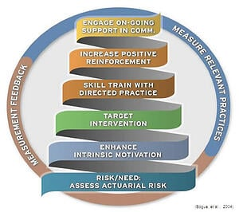

Slide 11
What the research says…
Supervision alone will not be sufficient to change behavior.
Punishment programs do not work to change behavior.
Need services that are behavioral in nature.

Slide 12
2022 Second Chance Act Jail Survey Results for the 20th Judicial District
How many times have you been incarcerated?
Data:
Value | Percent | Count
0 | 3.8% | 3
1 | 5.0% | 4
2 | 11.3% | 9
3-5 | 18.8% | 15
6-9 | 16.3% | 13
10-15 | 22.5% | 18
16+ | 22.5% | 18
 | Totals | 80

Slide 13
Perception of Substance Use:
Awareness of Local Help and Resources:
75.3% Agreed/Strongly Agreed that they have a drug/alcohol problem.
72.8% reported that someone in their family has a drug/alcohol problem.
82.7% reports that their “community” has a drug/alcohol problem.
75.3% agreed/strongly agreed that daily illegal drug use (77.7%) and alcohol use (72.9%) is harmful.
A larger percentage of inmates what successfully completed probation reported awareness of local resources to help than did those who had not successfully completed probation (79% versus 62.5%)
88.8% disagreed with the statement “You can’t help people who have a drug or alcohol problem”
Center for Community Supports and Learning Tree Institute at Greenbush

Slide 14

BEHAVIOR: What we see
Motivation Skills Competency Knowledge Values Beliefs
Self-Image Thoughts Past Trauma Attitudes
THINKING DRIVES BEHAVIOR!

Slide 15
Principles of Effective Intervention
RISK
NEED
RESPONSIVITY
WHO
Deliver more intense intervention to higher risk offenders.
WHAT
Target criminogenic needs to reduce risk for recidivism.
HOW
Use Cognitive-Behavioral approach.
Match mode/style of service to the offender.

Slide 16
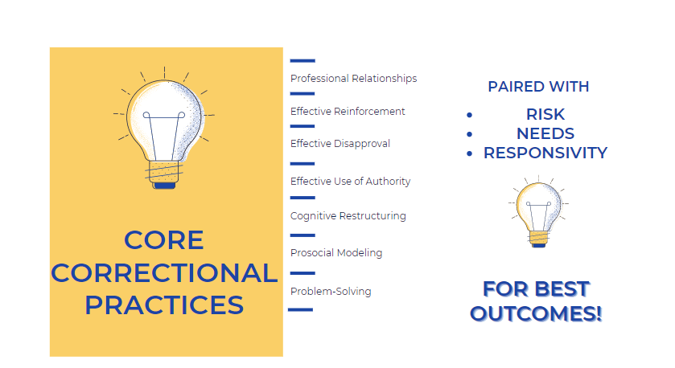

Slide 17
HOW ARE WE DOING?
86%
Overall satisfaction with CKCC services.
91%
Resourceful information, advice, and support are made available to you.
93%
Have an understanding of the terms and conditions of supervision.
90%
Staff have knowledge of community resources and refer as needed.
94%
Rate professionalism and knowledge of your supervision officer.
93%
Your ISO communicates in a language you understand.
88%
Staff are sympathetic to your individual needs while respecting your feelings.
90%
The behavior of staff makes you feel that you can trust and have confidence in them.
83%
Complaints are constructively handled.
Ratings are combined “Outstanding and Good”

Slide 18

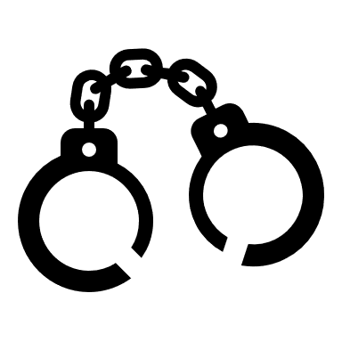
HIGHER RISK BEHAVIORS REQUIRE IMMEDIATE RESPONSES!!

Slide 19
Automatic Responses:
Drug testing
Non-compliance
New crimes – Revocation request:
Fail to submit to drug testing.
Fail to admit to drug use.
Attempting to adulterate drug testing.
Failure to report for scheduled appointments, treatment or groups.
Failure to comply with sanctions.
High-risk behaviors in which there is a need to protect public safety / safety of the probationer.
New felony
Gun crimes.
Person felonies.
Sales/Distribution cases.
Judges make the final revocation decisions.

Slide 20
What Makes Community Corrections Unique?
We evaluate the program each year with our Advisory Board, make program adjustments and implement change to increase the success of our population.
Complete and maintain certifications to conduct validated risk assessments as well as maintain annual training (40 hrs/yr) for case management.
Multiple layers of oversight: County Administrator/Fiscal Officer, Advisory Board, Commissioners, and the Kansas Department of Corrections.
CKCC aims to prevent future crime by using solutions and responses unique to our community.

Slide 21

Our agency promotes a culture of community involvement with other stakeholders - aimed at strengthening capacities and ultimately maximizing opportunities!
Achieving in the community…

Slide 22
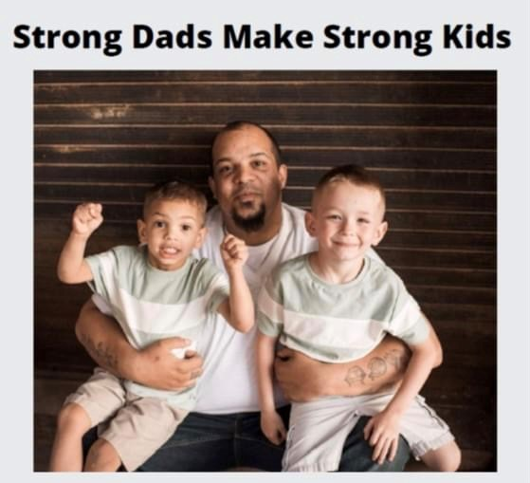
Behavioral Health Advisory Council: creating board/oversight for behavioral health agencies and initiatives.
Core Community:
Poverty resolution program
Peer Navigation:
Peers helping peers to get services and support for their SUD!
Fatherhood Initiative:
Strong Dads make Strong Kids
Rise Up:
Providing Prevention, Intervention and Resilience information to the community.
Rise Up HEART:
Providing mobile meetings to address health equity issues for those with Substance Use Disorder.
Solidarity Program:
Federal grant to divert high-risk probationers from prison using intensive SUD services and technology.
Stepping Up Community, NAMI and Jail MH program:
Addressing mental health needs to lower incarceration rates.

Slide 23

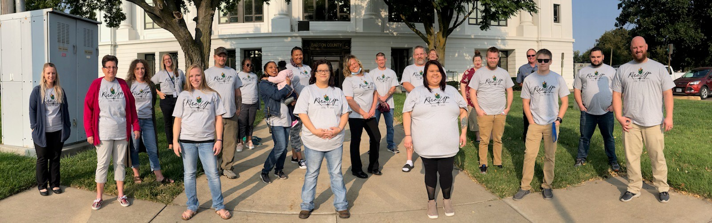
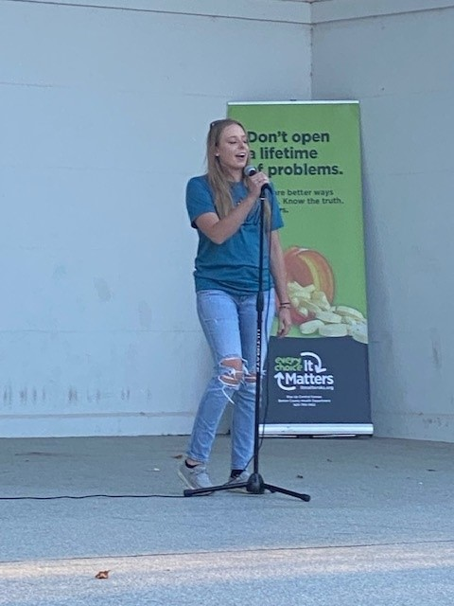
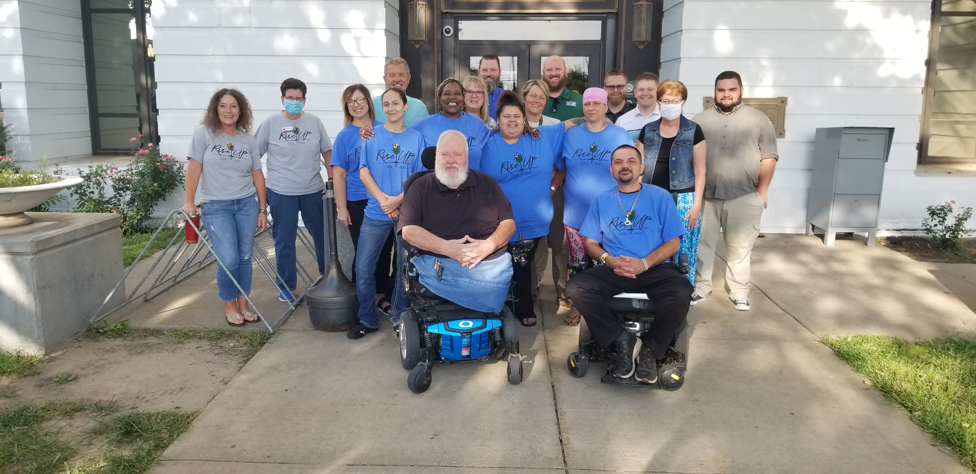
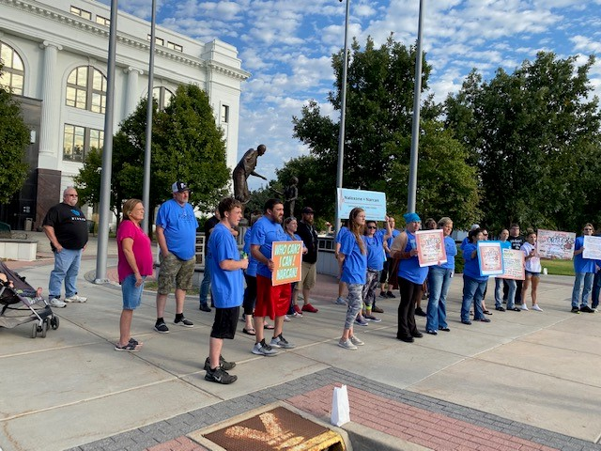
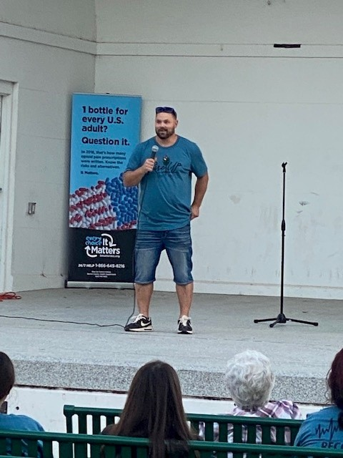

Slide 24

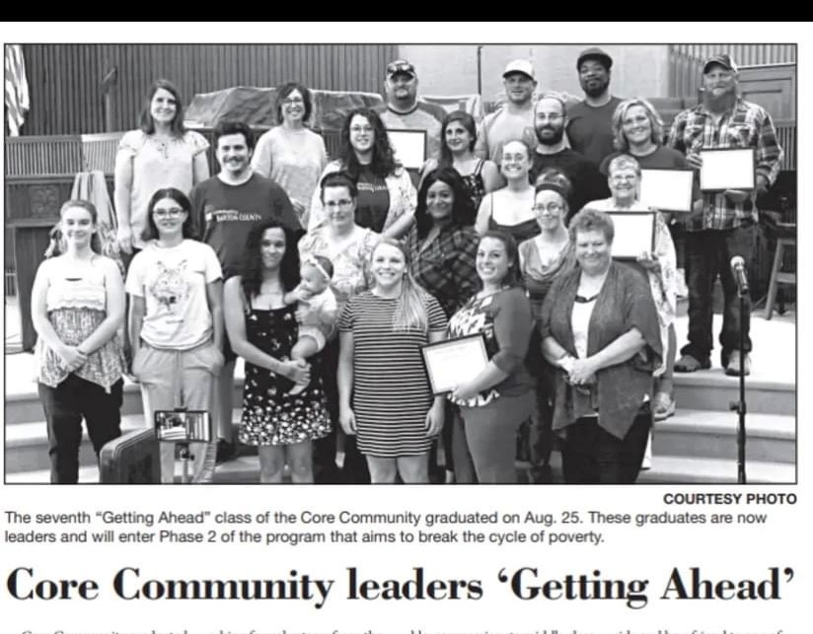
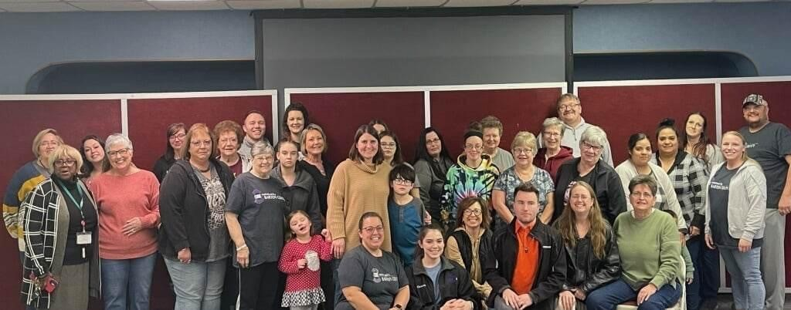
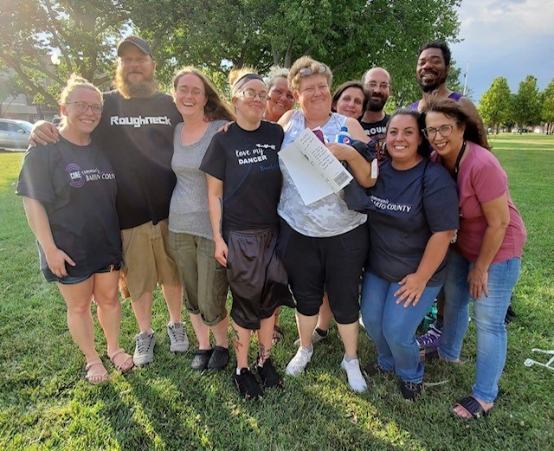

Slide 25
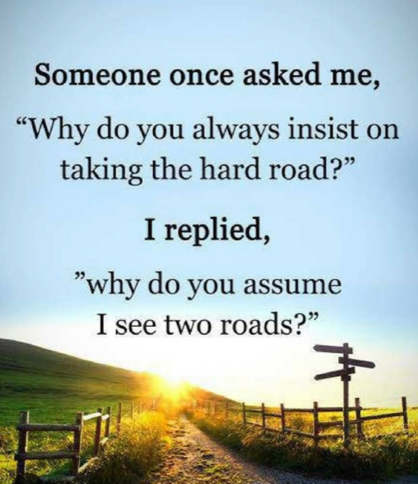

Slide 26

Thank you for your participation.
Questions?

